Slide 1











Thank you to our sponsors!
Gold Sponsors
Silver Sponsors
Community Sponsors

Slide 2
Azure Data Lake
An intro to
Rick van den Bosch
M +31 (0)6 52 34 89 30
r.van.den.bosch@betabit.nl

Slide 3
Calendar
Data Lakes
About Azure Data Lake
Azure Data Lake Store
DEMO
Azure Data Lake HDInsights
DEMO
Azure Data Lake Analytics
DEMO
Power BI
DEMO
Resources

Slide 4


Rick van den Bosch Cloud Solutions Architect
@rickvdbosch rickvandenbosch.net r.van.den.bosch@betabit.nl

Slide 5
Data Lakes

Slide 6

The Traditional Data Warehouse
BI and analytics
2
Real-time
data
Dashboards
Reporting
Data warehouse
ETL
1
3
4
Increasing
data volumes
New data
sources and types
Cloud-born
data
Data sources
Non-relational data
OLTP
ERP
CRM
LOB
Devices
Web
Sensors
Social

Slide 7
The Data Lake Approach
Ingest all data regardless of requirements
Store all data
in native format without schema definition
Do analysis
Hadoop, Spark, R, Azure Data Lake Analytics (ADLA)
Devices
Social
Batch queries
LOB applications
Video
Devices
Interactive queries
LOB applications
Social
Real-time analytics
Web
Sensors
Sensors
Video
Machine Learning
Relational
Web
Clickstream
Data warehouse
Relational
Clickstream
Designed for the questions you don’t yet know!

Slide 8

About Azure Data Lake

Slide 9
Azure Data Lake
Store and analyze petabyte-size files and trillions of objects
Develop massively parallel programs with simplicity
Debug and optimize your big data programs with ease
Enterprise-grade security, auditing, and support
Start in seconds, scale instantly, pay per job
Built on YARN, designed for the cloud

Slide 10
Azure Data Lake
Data Lake Analytics—a no-limits analytics job service to power intelligent action
HDInsight—cloud Apache Spark and Hadoop® service for the enterprise
Data Lake Store—a no-limits data lake that powers big data analytics
Develop, debug, and optimize big data programs with ease
Integrates seamlessly with your existing IT investments
Store and analyze petabyte-size files and trillions of objects
Affordable and cost effective
Enterprise grade security, auditing, and support

Slide 11
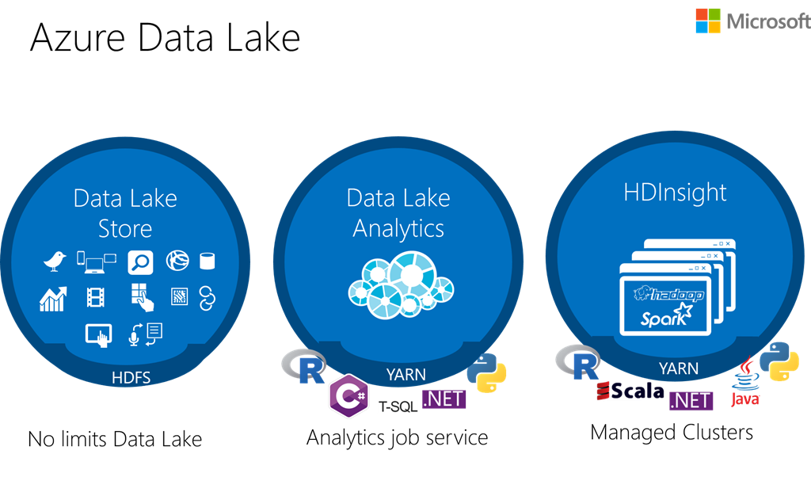

Slide 12




Why Azure Data Lake?
an on-demand, real-time stream processing service with no-limits data lake built to support massively parallel analytics
Performance at scale
Optimized for analytics
Multiple analytics engines
Single repository sharing
HDInsight
ADL Analytics
Open Source Apache Hadoop ADL Client
Azure DataBricks
Hive
.NET, SQL, Python, R scaled out by U-SQL
HDFS Compatible REST API
ADL Store
1
1
1
1
1
1
1
1
1
1
1
1

Slide 13
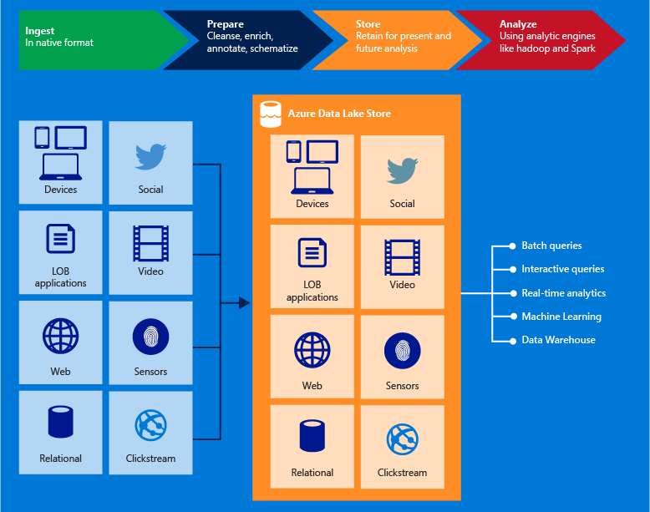

Slide 14

Azure Data Lake Store

Slide 15
Store
Enterprise-wide hyper-scale repository
Data of any size, type and ingestion speed
Operational and exploratory analytics
WebHDFS-compatible API
Specifically designed to enable analytics
Tuned for (data analytics scenario) performance
Out of the box: security, manageability, scalability, reliability, and availability
Notes:
WebHDFS means Hadoop & HDInsight compatibility

Slide 16
Store
Architected and built for very high throughput at scale for Big Data workloads
No limits to file size, account size or number of files
Single-repository for sharing
Cloud-scale distributed filesystem with file/folder ACLS and RBAC
Encryption-at-rest by default with Azure Key Vault
Authenticated access with Azure Active Directory integration
The Big Data platform for Microsoft

Slide 17
Key capabilities
Built for Hadoop
Unlimited storage, petabyte files
Performance-tuned for big data analytics
Enterprise-ready: Highly-available and secure
All data
Notes:
Apache Hadoop file system compatible with Hadoop Distributed File System (HDFS) and works with the Hadoop ecosystem
It does not impose any limits on account sizes, file sizes, or the amount of data that can be stored in a data lake. Data is stored durably by making multiple copies and there is no limit on the duration of time
The data lake spreads parts of a file over a number of individual storage servers. This improves the read throughput when reading the file in parallel for performing data analytics.
Redundant copies, enterprise-grade security for the stored data
Data in native format, loading data doesn’t require a schema, structured, semi-structured, and unstructured data

Slide 18
Security
Authentication
Azure Active Directory integration
Oauth 2.0 support for REST interface
Access control
Supports POSIX-style permissions (exposed by WebHDFS)
ACLs on root, subfolders and individual files
Encryption
Notes:
including multi-factor authentication, conditional access, role-based access control, application usage monitoring, security monitoring and alerting, etc.
Do not enable encryption.
Use keys managed by Data Lake Storage Gen1
Use keys from your own Key Vault.

Slide 19
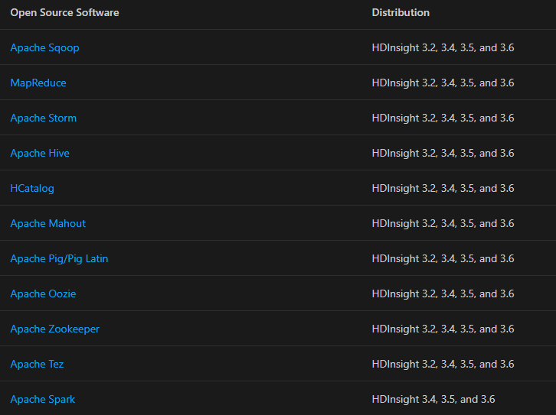
Compatibility

Slide 20
Store
HDFS Compatible REST API
ADL Store
1
1
1
1
1
1
1
1
1
1
1
1

Slide 21
DEMO - Store

Slide 22
Ingest data – Ad hoc
Local computer
Azure Portal
Azure PowerShell
Azure CLI
Using Data Lake Tools for Visual Studio
Azure Storage Blob
Azure Data Factory
AdlCopy tool
DistCp running on HDInsight cluster

Slide 23
Ingest data
Streamed
Azure Stream Analytics
Azure HDInsight Storm
EventProcessorHost
Relational
Apache Sqoop
Azure Data Factory
Web server
Upload using custom applications
Azure CLI
Azure PowerShell
Azure Data Lake Storage Gen1 .NET SDK
Azure Data Factory

Slide 24
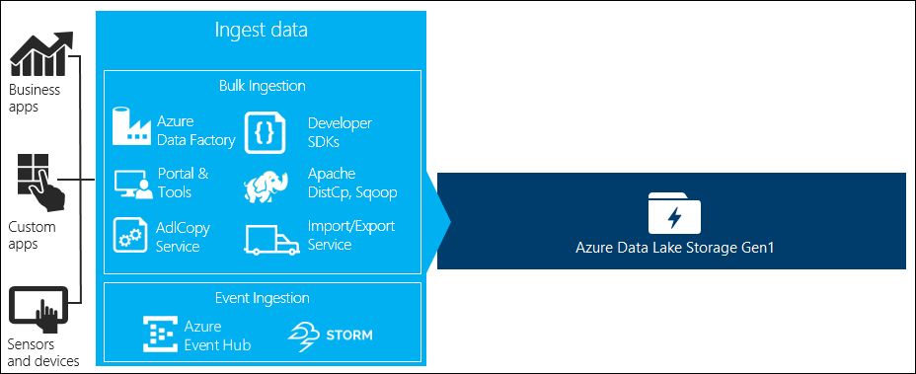
Ingest data

Slide 25
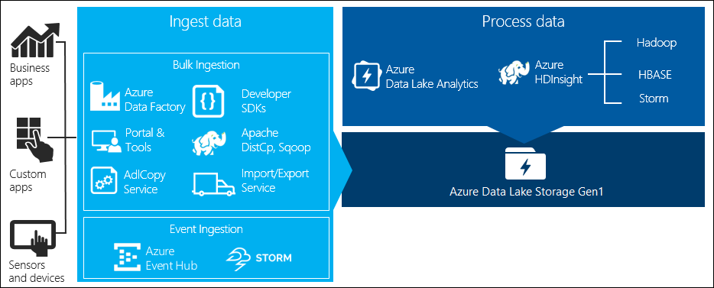
Process data
Notes:
You can use Azure HDInsight and Azure Data Lake Analytics to run data analysis jobs on the data stored in Data Lake Storage Gen1.

Slide 26
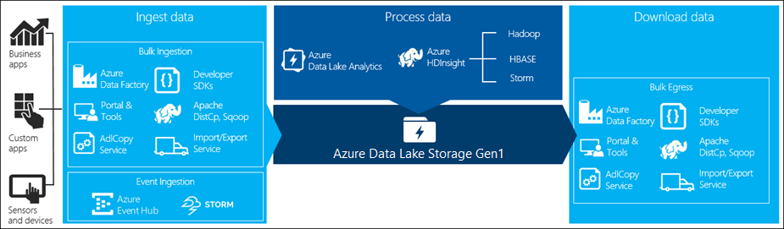
Download data
Notes:
Apache Sqoop, Azure Data Factory, Apache DistCp
Custom script / application
Azure CLI, Azure PowerShell, Azure Data Lake Storage Gen1 .NET SDK

Slide 27
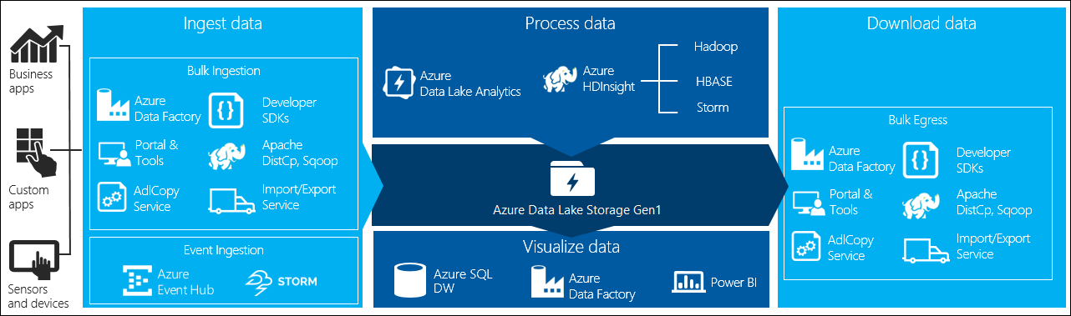
Visualize data

Slide 28
ADLS Gen 2
Takes core capabilities from Azure Data Lake Storage Gen1 such as
a Hadoop compatible file system
Azure Active Directory
POSIX based ACLs
and integrates them into Azure Blob Storage
Notes:
Because Azure Data Lake Storage Gen2 is integrated into the Azure Storage platform, applications can use either the BLOB APIs or Azure Data Lake Storage Gen2 file system APIs for accessing data.
BLOB APIs allow you to leverage your existing investments in BLOB Storage and continue to take advantage of the large ecosystem of first and third party applications already available while the Azure Data Lake Storage Gen2 file system APIs are optimized for analytics engines like Hadoop and Spark.

Slide 29
Additional benefits
Unlimited scale and performance
Performance improvements reading/writing individual objects (> throughput & concurrency)
Removes need to decide a priority: run analytics or not at data ingestion time
Data protection capabilities: encryption at rest
Integrated network Firewall capabilities
Durability options (Zone and Geo-Redundant Storage: high-availability and disaster recovery)
Linux integration – BlobFUSE
mount Blob Storage from Linux VMs
interact using standard Linux shell commands.

Slide 30

Data Lake Storage Gen2
“In Data Lake Storage Gen2, all the qualities of object storage remain while adding the advantages of a file system interface optimized for analytics workloads.”

Slide 31
Known issues
Blob Storage APIs and Azure Data Lake Gen2 APIs aren't interoperable
Blob storage APIs not available
Azure Storage Explorer >= 1.6.0
AZCopy >= v10
Event Grid doesn't receive events
Soft Delete and Snapshots not available
Object level storage tiers not available
Diagnostic logs not available
Notes:
Storage Explorer in portal WILL NOT WORK, Blob Viewing Tool partial support

Slide 32

Azure Data Lake HDInsight

Slide 33
HDInsight
Cloud distribution of the (Hortonworks) Hadoop components
Supports multiple Hadoop cluster versions (can be deployed any time)
Hadoop
YARN for job scheduling & resource management
MapReduce for parallel processing
HDFS

Slide 34
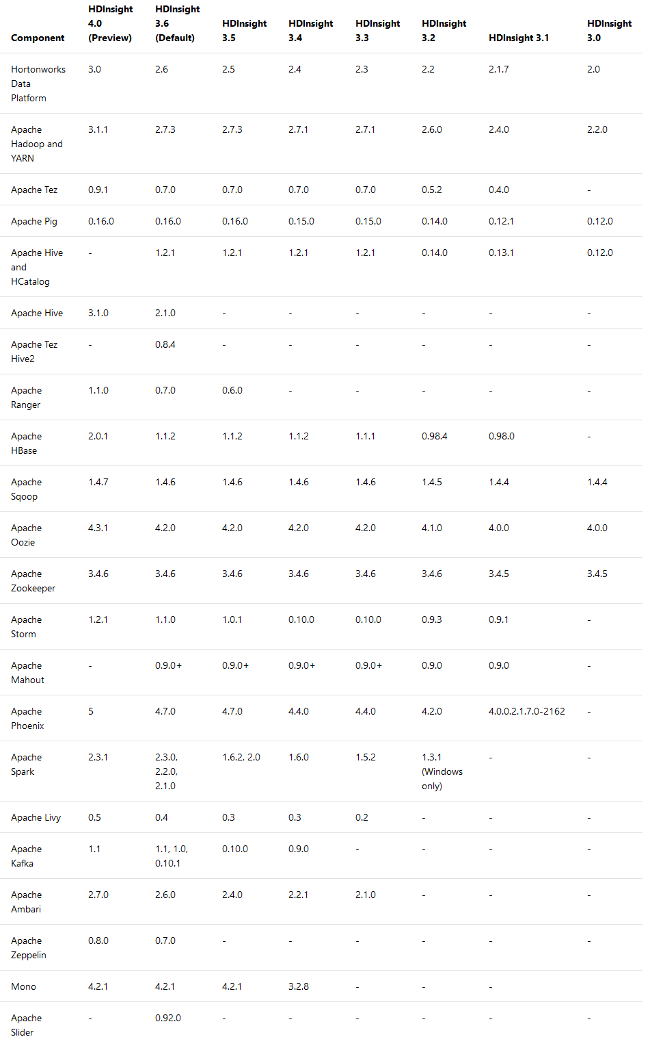

Slide 35
HDInsight
HDInsight
Open Source Apache Hadoop ADL Client
Azure DataBricks
Hive

Slide 36
DEMO - HDInsight

Slide 37
Azure Data Lake Analytics

Slide 38
Analytics
Dynamic scaling
Develop faster, debug and optimize smarter using familiar tools
U-SQL: simple and familiar, powerful, and extensible
Integrates seamlessly with your IT investments
Affordable and cost effective
Works with all your Azure data

Slide 39
Analytics
On-demand analytics job service to simplify big data analytics
Can handle jobs of any scale instantly
Azure Active Directory integration
U-SQL

Slide 40

Azure Data Lake Analytics
Serverless. Pay per job. Starts in seconds. Scales instantly.
Develop massively parallel programs with simplicity
Federated query from multiple data sources
ADL Analytics
Analytics
.NET, SQL, Python, R scaled out by U-SQL
Storage
HDFS Compatible REST API
ADL Store
1
1
1
1
1
1
1
1
1
1
1
1

Slide 41
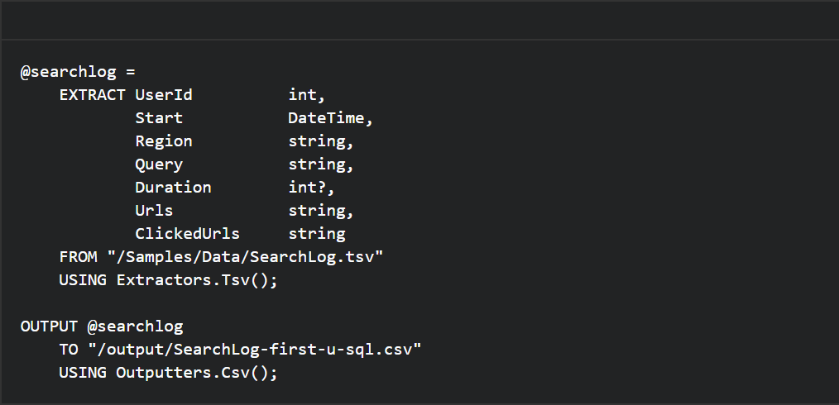
U-SQL
Language that combines declarative SQL with imperative C#

Slide 42
U-SQL – Key concepts
Rowset variables
Each query expression that produces a rowset can be assigned to a variable.
EXTRACT
Reads data from a file & defines the schema on read *
OUTPUT
Writes data from a rowset to a file *

Slide 43
U-SQL – Scalar variables
DECLARE @in string = "/Samples/Data/SearchLog.tsv";
DECLARE @out string = "/output/SearchLog-scalar-variables.csv";
@searchlog =
EXTRACT UserId int,
ClickedUrls string
FROM @in
USING Extractors.Tsv();
OUTPUT @searchlog
TO @out
USING Outputters.Csv();

Slide 44
U-SQL – Transform rowsets
@searchlog =
EXTRACT UserId int,
Region string
FROM "/Samples/Data/SearchLog.tsv"
USING Extractors.Tsv();
@rs1 =
SELECT UserId, Region
FROM @searchlog
WHERE Region == "en-gb";
OUTPUT @rs1
TO "/output/SearchLog-transform-rowsets.csv"
USING Outputters.Csv();

Slide 45
U-SQL – Extractor parameters
delimiter
encoding
escapeCharacter
nullEscape
quoting
rowDelimiter
silent
skipFirstNRows
charFormat

Slide 46
U-SQL – Outputter parameters
delimiter
dateTimeFormat
encoding
escapeCharacter
nullEscape
quoting
rowDelimeter
charFormat
outputHeader

Slide 47

U-SQL
Built-in extractors and outputters:
Text
Csv
Tsv
A (for instance) CSV Extractor or Outputter is EXACTLY THAT

Slide 48
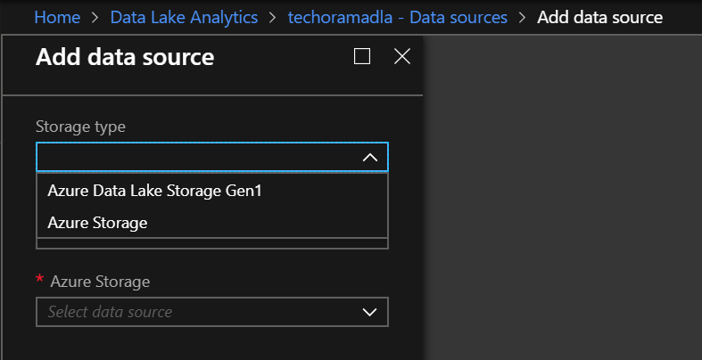
Data sources
Options in the Azure Portal:
Data Lake Storage Gen1
Azure Storage

Slide 49
DEMO - Analytics

Slide 50
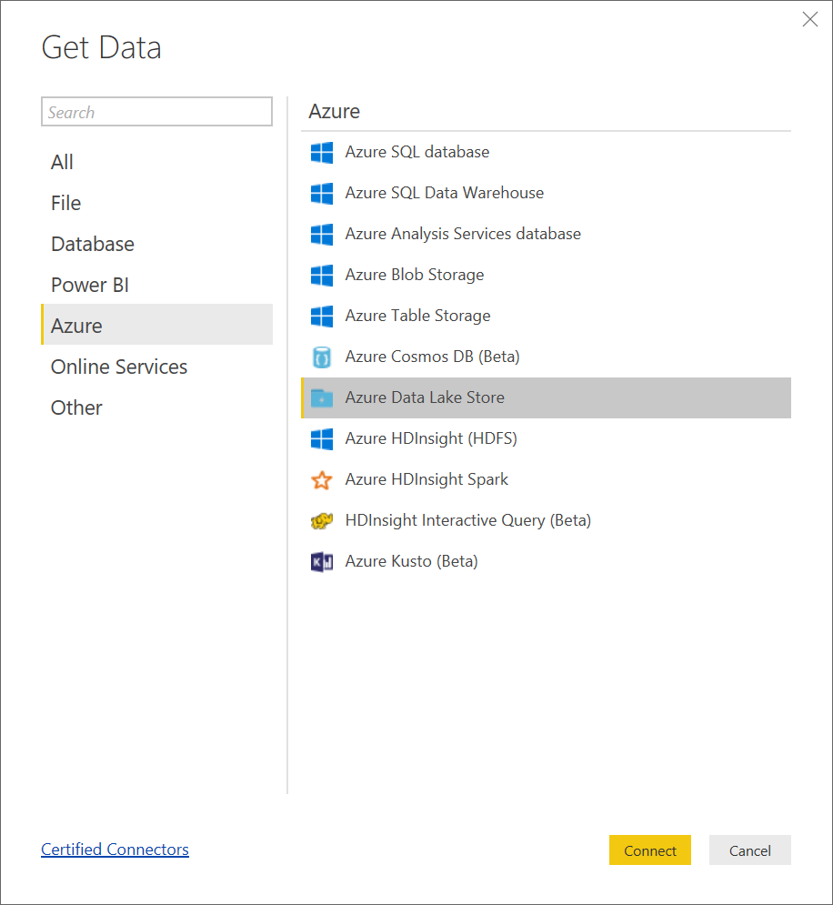

DEMO - Power BI

Slide 51
Using Azure SQL in analytics

Slide 52
Data Sources
CREATE DATA SOURCE –statement
Azure SQL Database
Azure SQL Datawarehouse
SQL Server 2012 and up in an Azure VM

Slide 53
Create Azure SQL Data Source
Make sure your SQL Server firewall settings allow Azure Services to connect
Create a ‘database’ in the Data Lake Analytics account
Create a Data Lake Analytics Catalog Credential
Create a Data Lake Analytics Data Source
Query your Azure SQL Database from Data Lake Analytics

Slide 54
Create ‘database’ in DLA (U-SQL)
CREATE DATABASE <YourDatabaseName>;

Slide 55
Create credential (PowerShell)
Login-AzureRmAccount;
Set-AzureRMContext -SubscriptionId <YourSubscriptionId>;
New-AzureRmDataLakeAnalyticsCatalogCredential
-AccountName "<YourDLAAccount>"
-DatabaseName "<YourDatabaseName>"
-CredentialName "YourCredentialName"
-Credential (Get-Credential)
-DatabaseHost "<YourAzureSqlServer>.database.windows.net"
-Port 1433;

Slide 56
Create Data Source (U-SQL)
USE DATABASE <YourDatabaseName>;
CREATE DATA SOURCE <YourDataSourceName>
FROM AZURESQLDB
WITH
(
PROVIDER_STRING =
"Database=<YourAzureSQLDatabaseName>;Trusted_Connection=False; Encrypt=True",
CREDENTIAL = <YourCredentialName>,
REMOTABLE_TYPES = (bool, byte, sbyte, int, string, …)
);

Slide 57
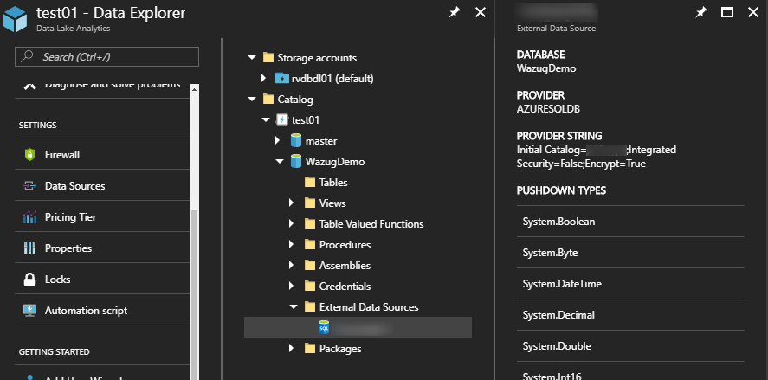
Data Source (under Data Explorer)

Slide 58
Query your Azure SQL Database (U-SQL)
USE DATABASE <YourDatabaseName>;
@results =
SELECT *
FROM EXTERNAL <YourDataSourceName> EXECUTE
@"<QueryForYourSQLDatabase>"; OUTPUT @results
TO "<OutputFileName>"
USING Outputters.Csv(outputHeader: true);

Slide 59
Resources

Slide 60
Resources
Basic example
Advanced example
Create Database (U-SQL) & Create Data Source (U-SQL)
This example
HDInsight quickstart
Azure blog
Azure roadmap

Slide 62
Track 1
15:35 – 16:20
Skynet Is Talking - Microsoft Bot Framework
Kris van der Mast
Track 2
15:35 – 16:20
Enter The Matrix: Securing Azure's Assets
Mike Martin

